Slide 1
Cloud/online library(python) ~Akshaj Agarwal

Slide 2
agenda
Introduction
Which software used
How is code made (Sources)
Explanation(code)

Slide 3
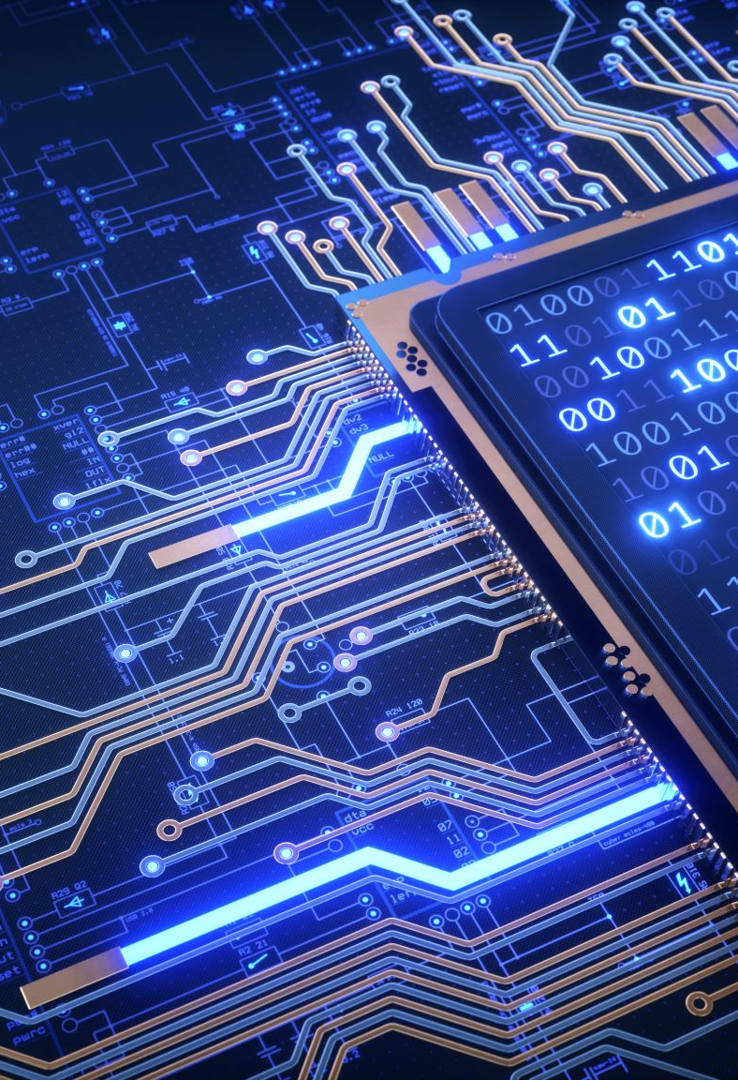
INTRODUCTION this presentation has been made for demand of checking knowledge. In this file you will get to know about my project(cloud/online library).

Slide 4


SOFTWARES USED IN MAKING PROJECT. antigravity visual studio code
VISUAL STUDIO CODE
ANTIGRAVITY

Slide 5
🧑‍💻!!How code is made!!🧑‍💻
Some part of code has been made by human(me)
Some part of code has been made by AI!!(Codex)
PROCESS:-
MADE A PART OF CODE MYSELF(TRIED)
TOOK HELP (UNDERSTOOD)
SELFWROTE
GAVE TO AI FOR CORRECTION (UNDERSTOOD )

Slide 6
📖📖EXPLANATION OF CODE 📖📖
OPEN THE FILE TO SEE THE CODE
**DISCLAIMER**
THE EXPLAINATION IS AI GENERATED
THE PPT IS HUMAN (ME) GENERATED

Slide 7
Thank you
AKSHAJ AGARWAL
CONTACT DETAILS:- +91 9883767011
EMAIL ID :-
~ akshajbitm@gmail.com
~amrstiltongamesfun19@gmail.com

